Slide 1
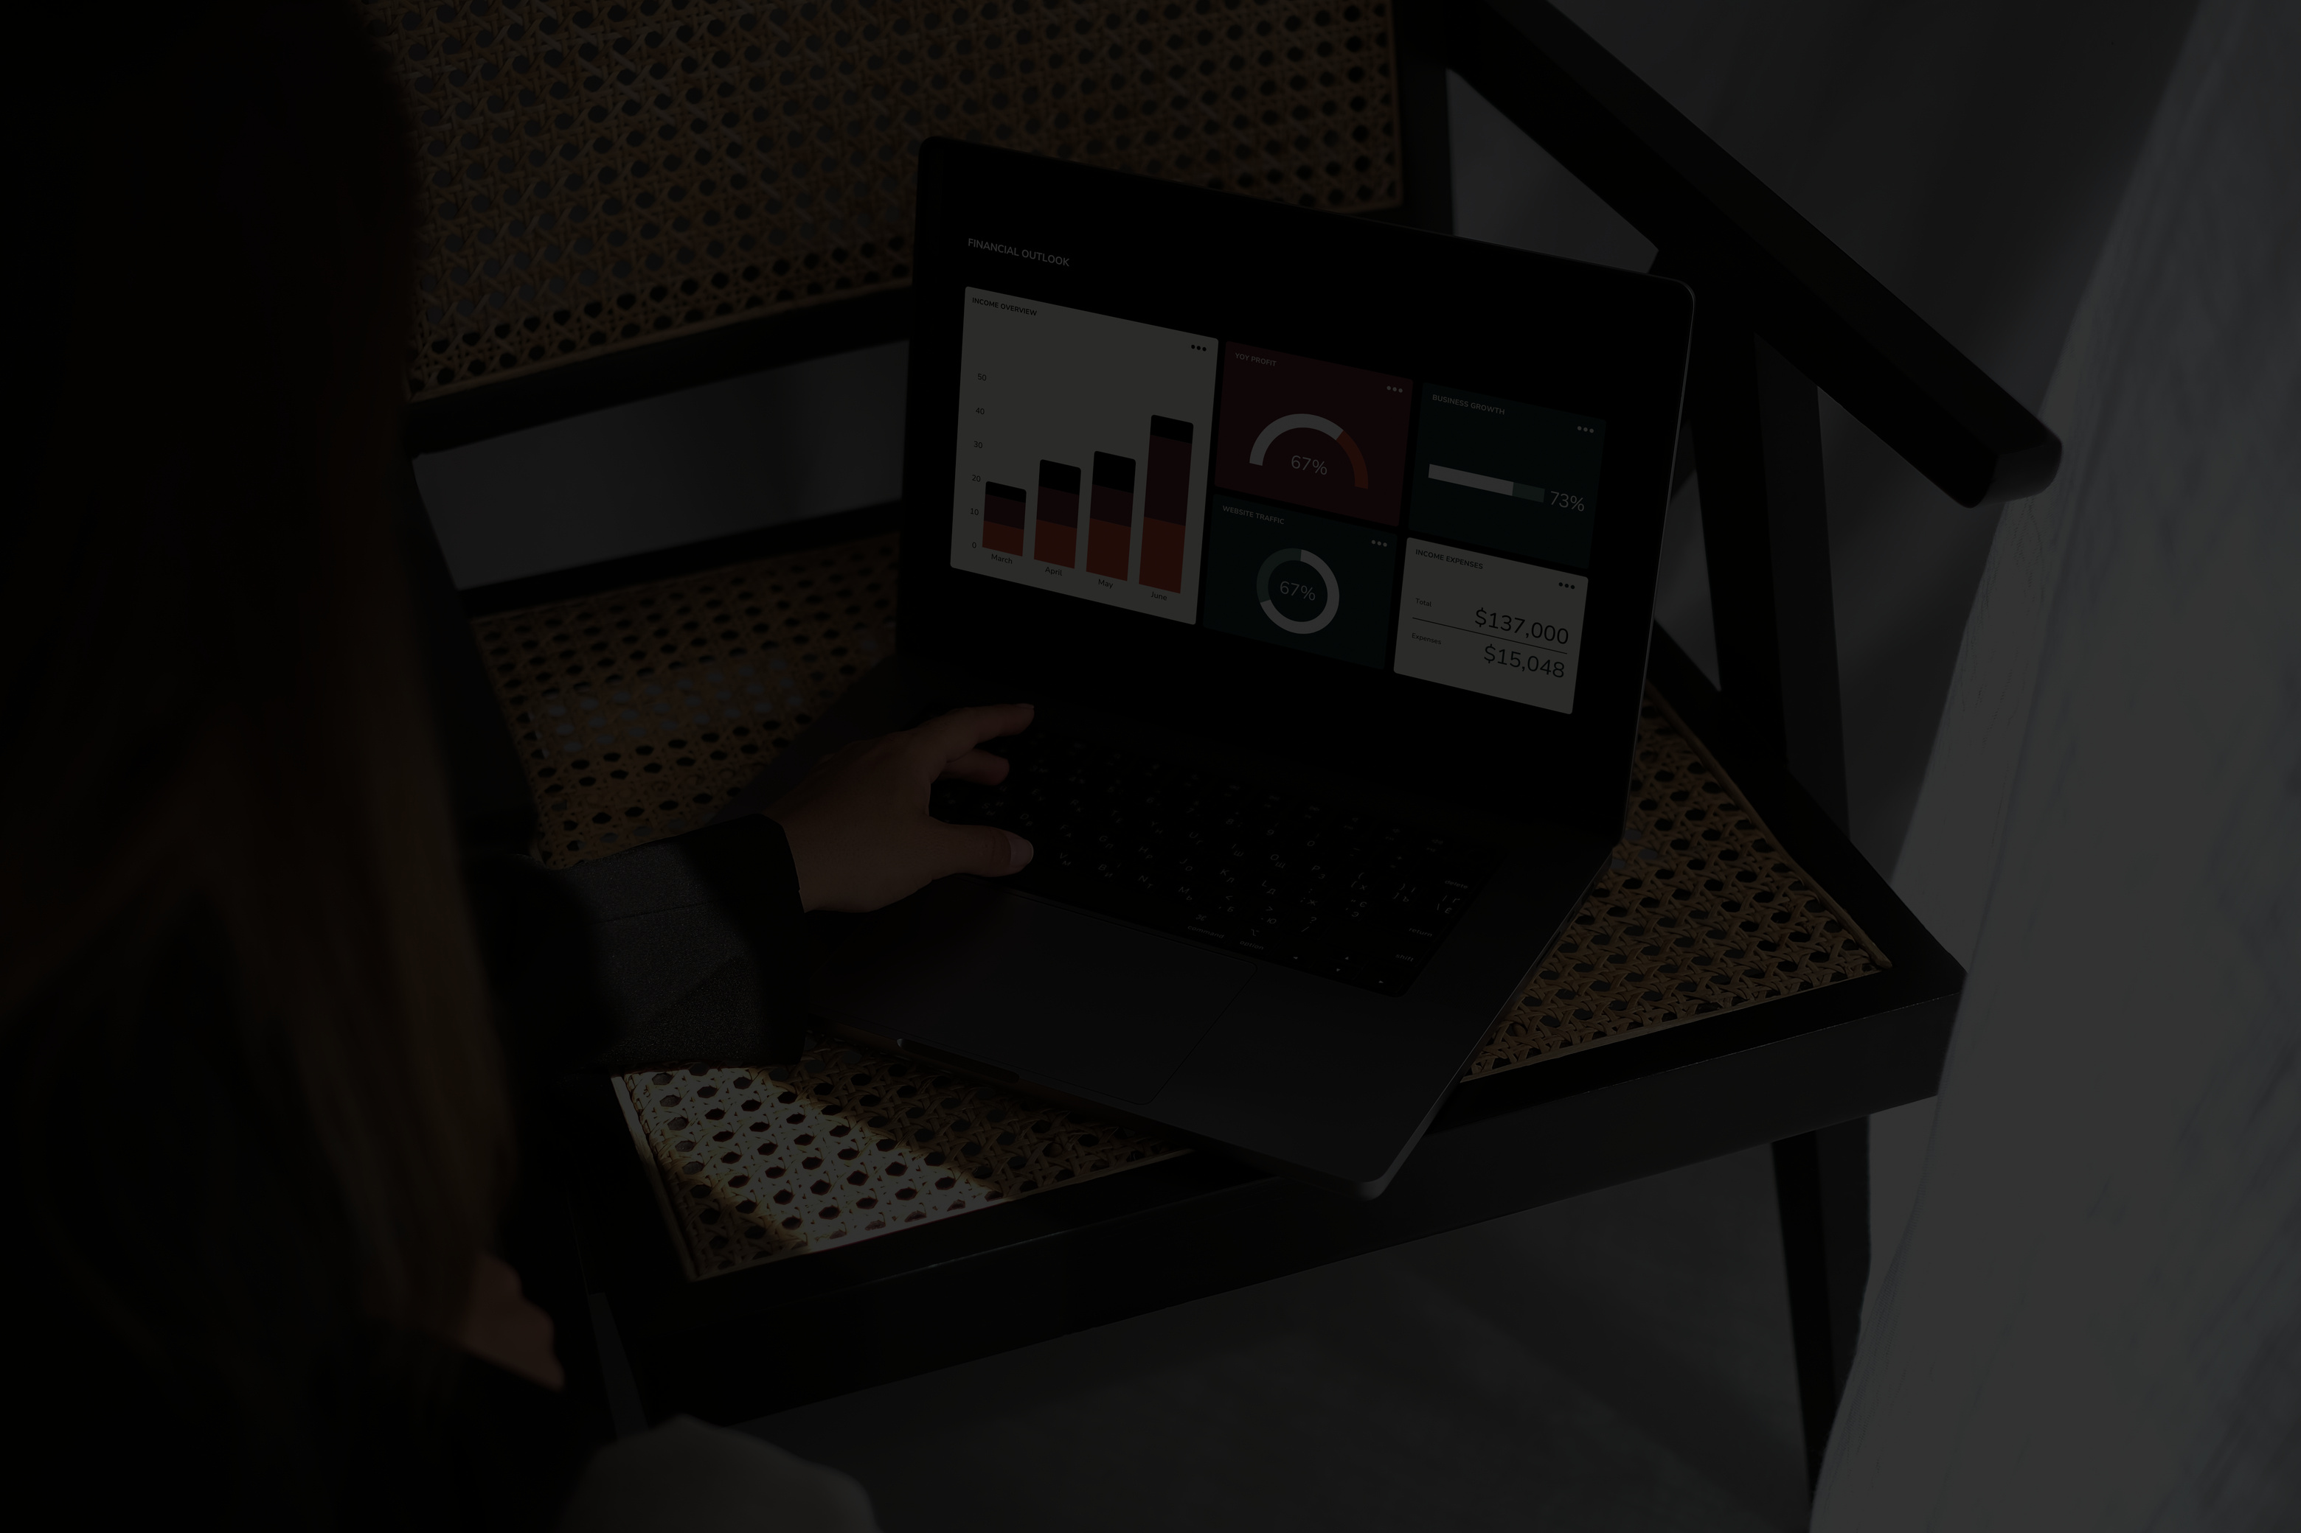
PRESENTATION
NETFLIX INSIGHTS :
AN ETL PIPELINE AND TABLEAU VISUALIZATION PROJECT
DATA WAREHOUSE & MINING
PROJECT :
GRP-15 (Sec -B) Grp Members: | Roll No.
Hassan Ahmad | 38
Laxmikant Dubey | 41
NIkunj chandak | 49
Sujit Dwiwedi | 75
GUIDED BY :
PROF. ARTI KARANDIKAR

Slide 2
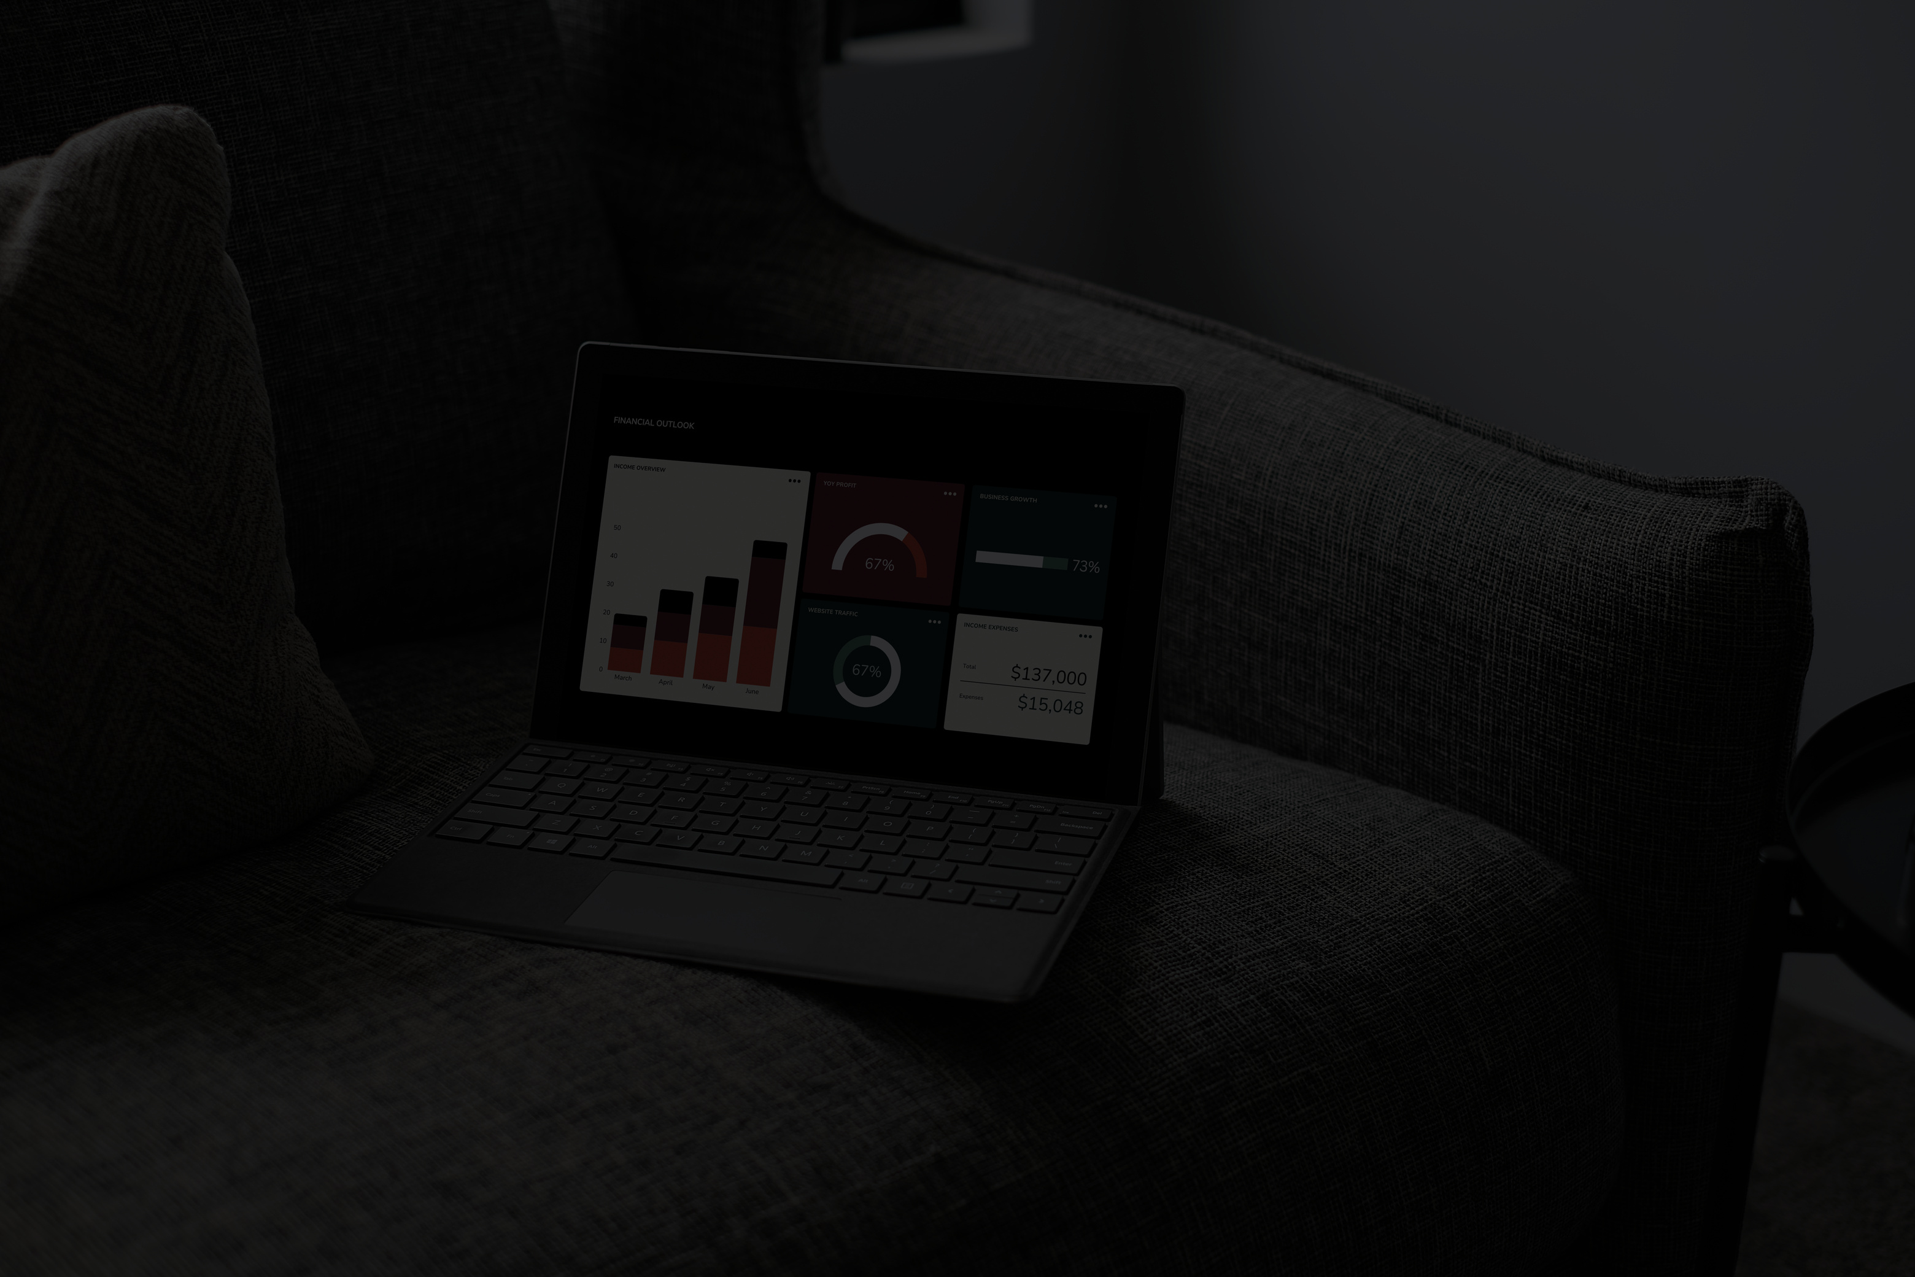
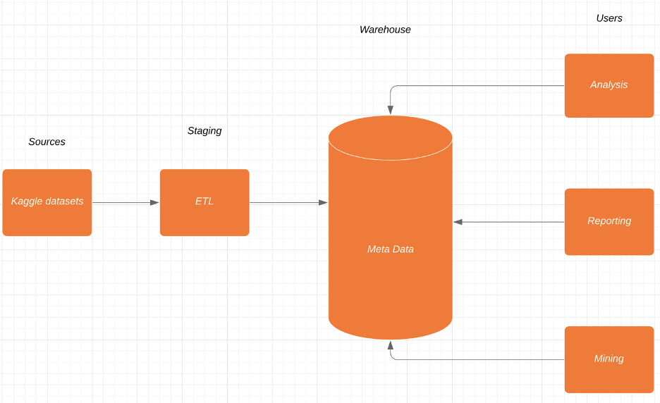
ETL PIPELINE

Slide 3
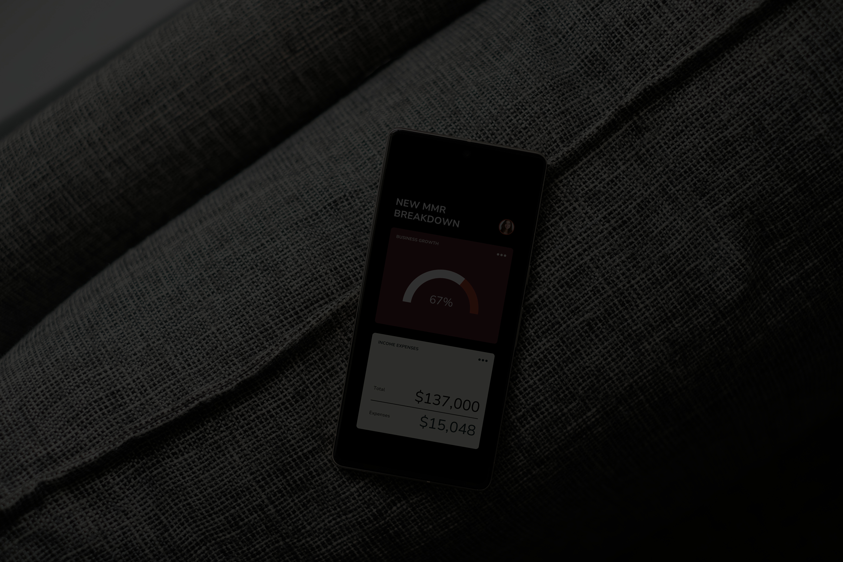
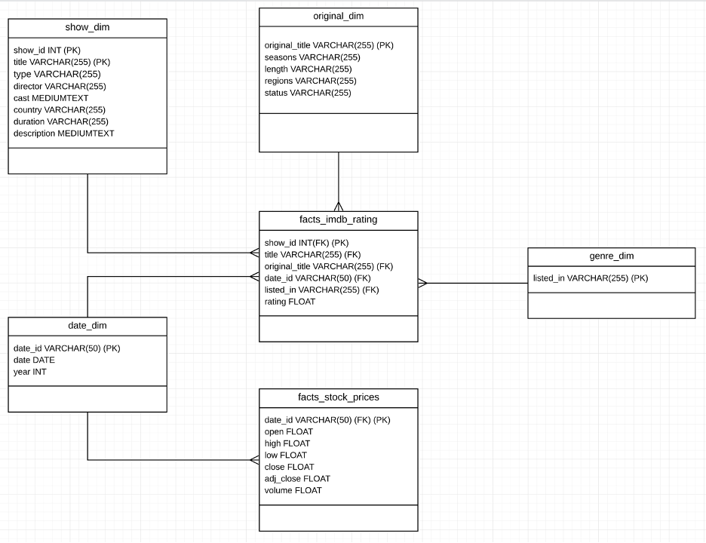
NETFLIX
DATABASE
SCHEMA

Slide 4
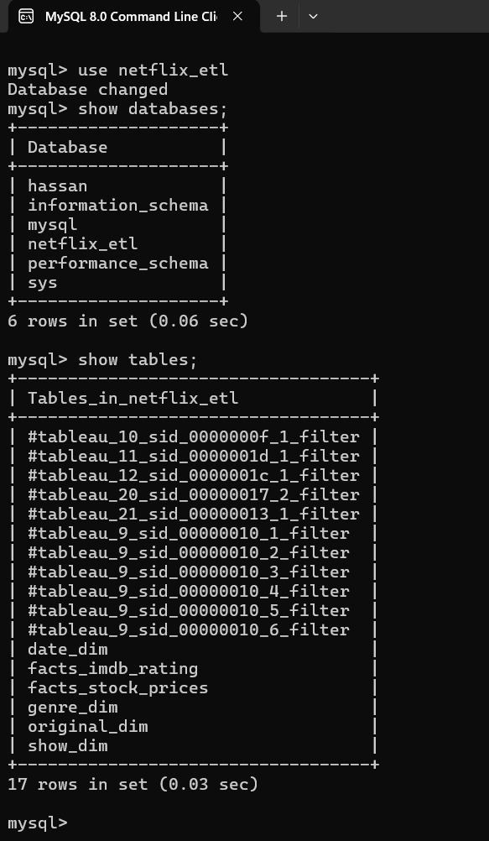
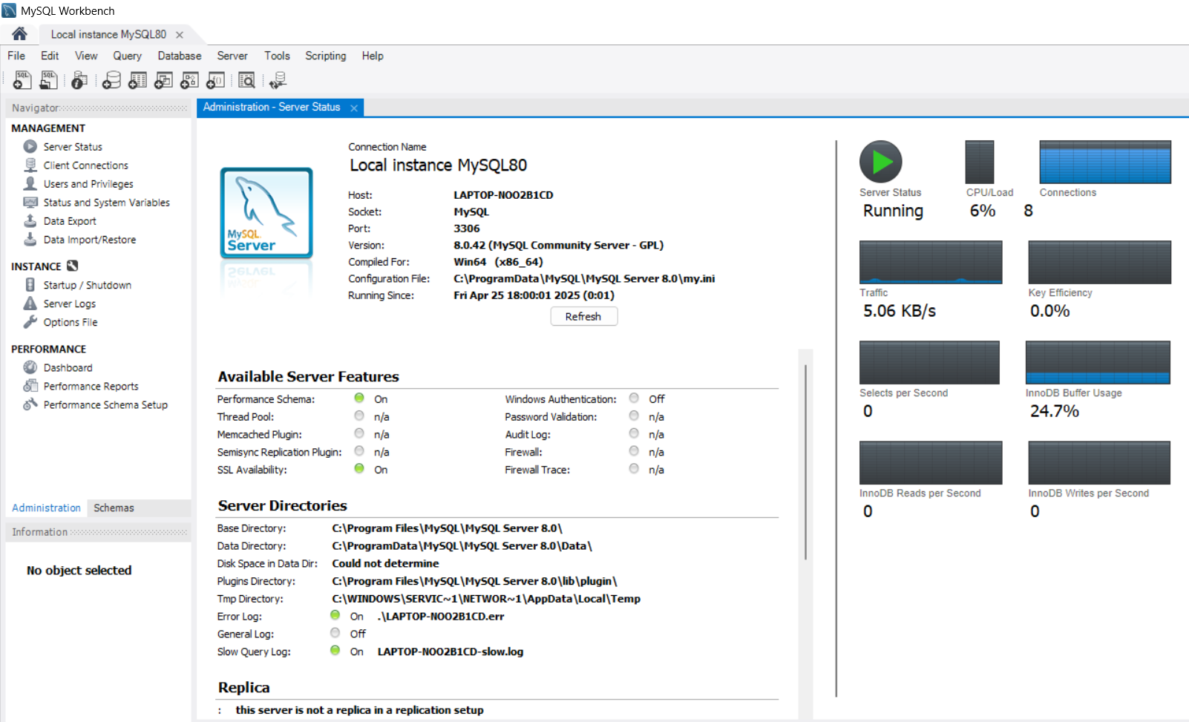
NETFLIX_ETL
DATABASE CREATED ON LOCAL MYSQL SERVER

Slide 5
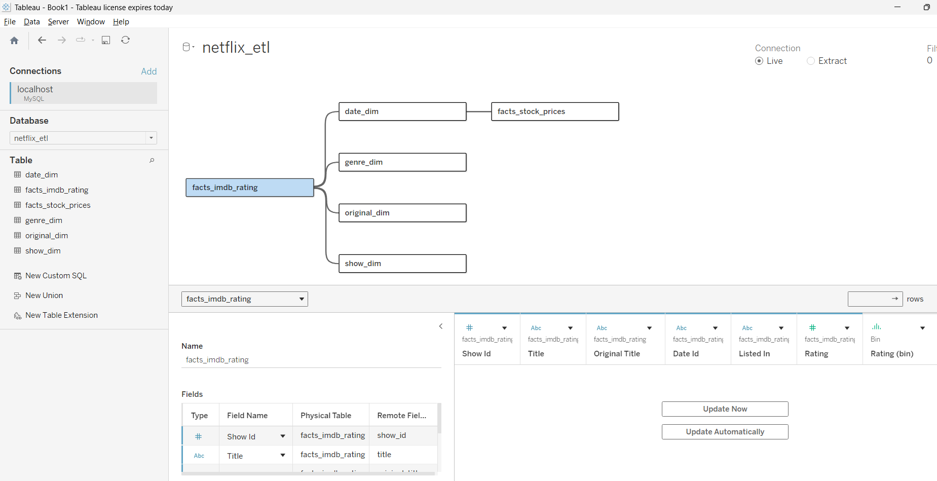
MYSQL NETFLIX_ETL DATABASE CONNECTED TO TABLEAU

Slide 6
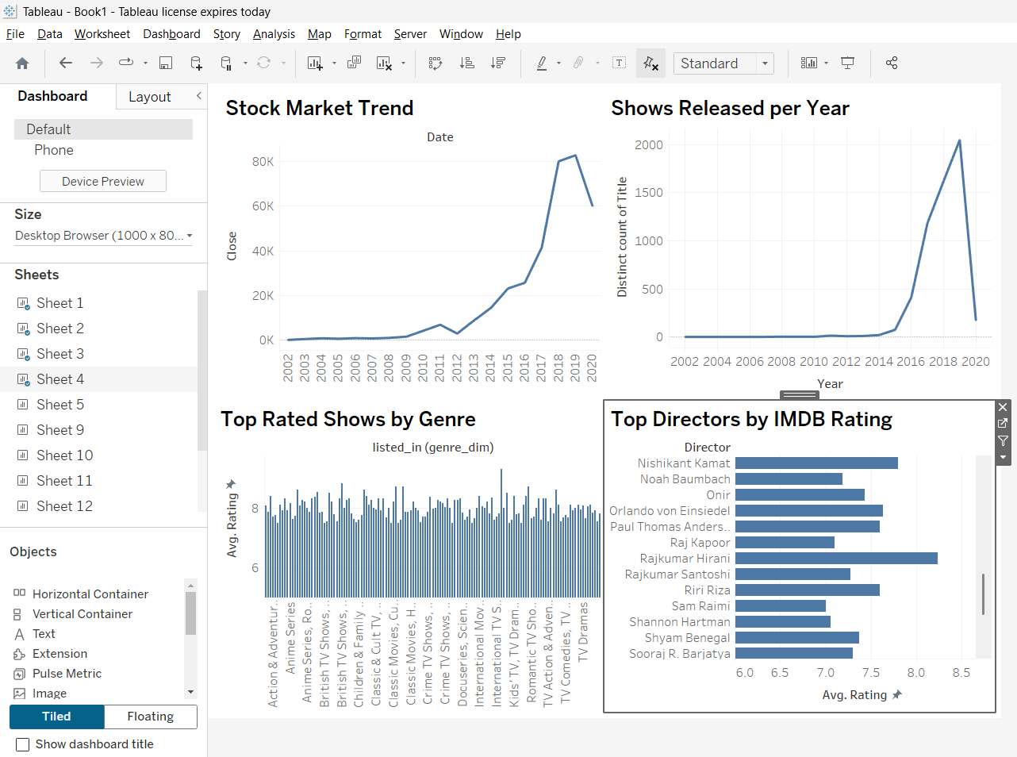
VISUALISATIONS OF NETFLIX DATABASE THROGH GRAPHS & PLOTS DASHBOARDS

Slide 7
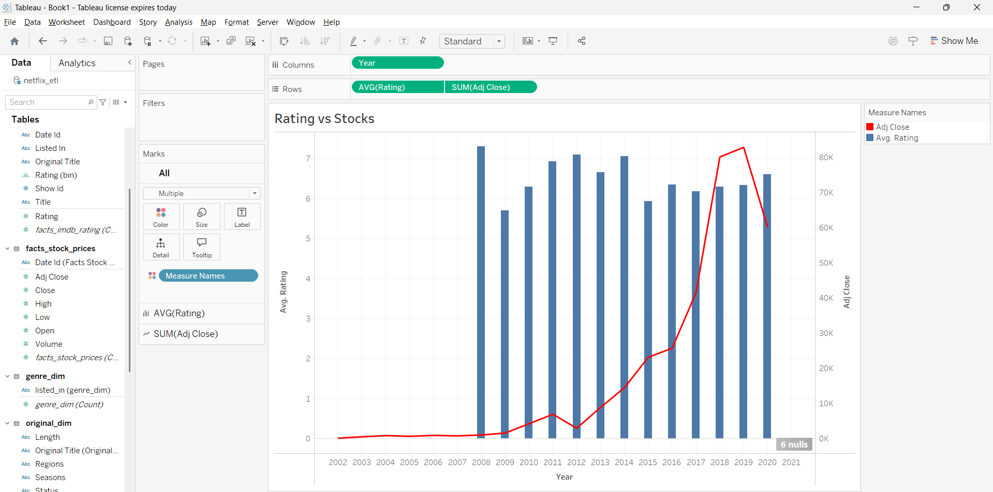

Slide 8
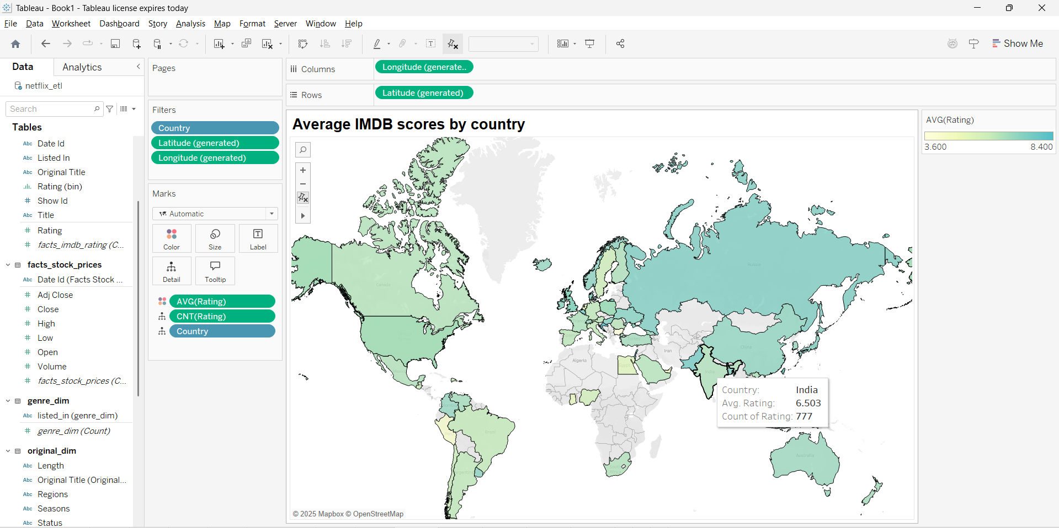

Slide 9
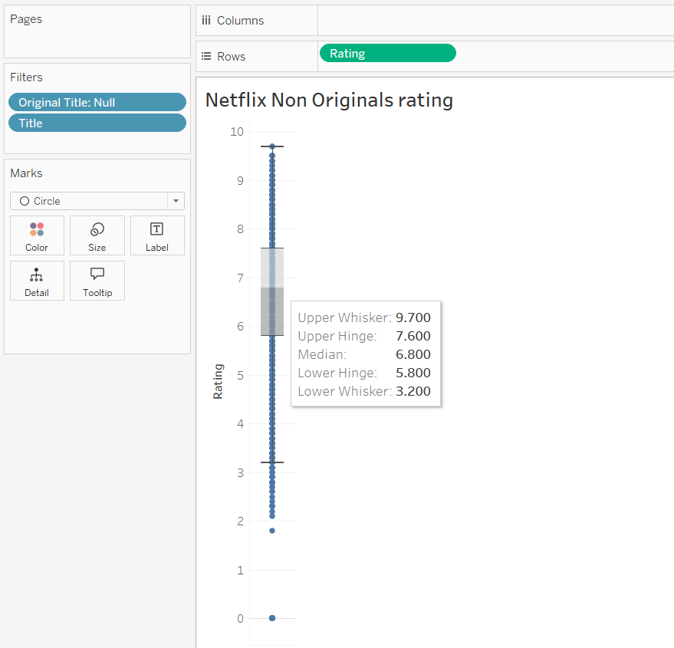
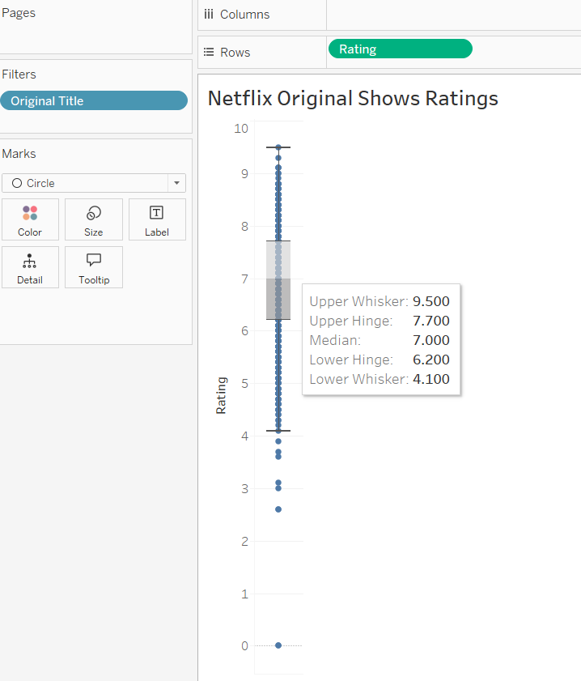

Slide 10
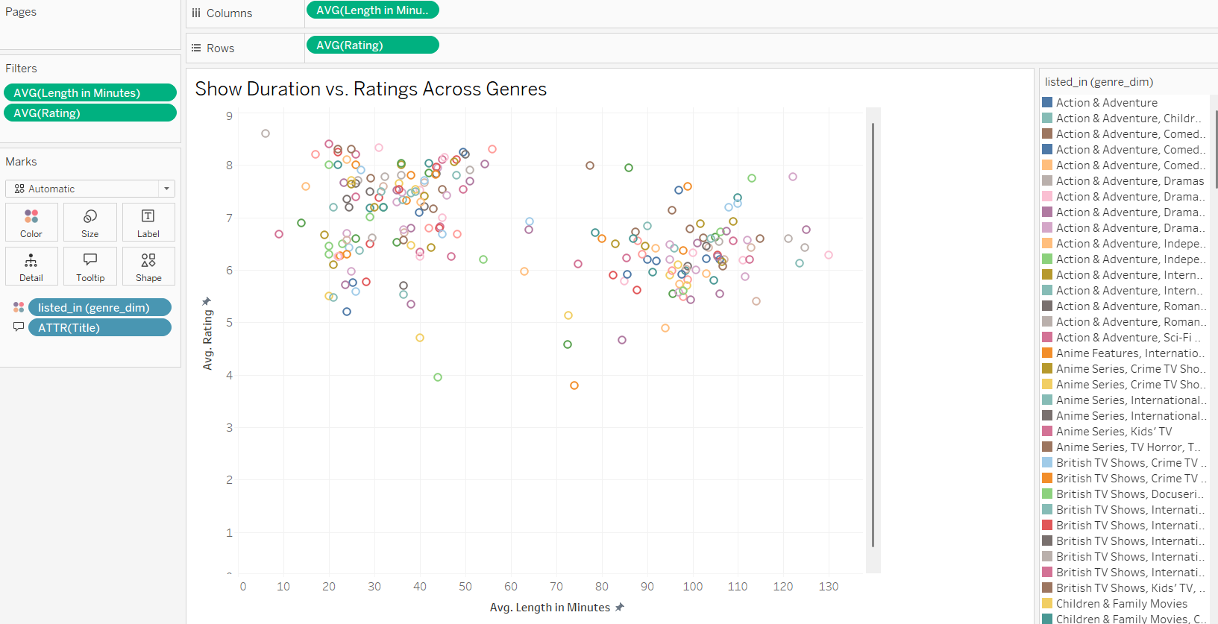

Slide 11
DATASETS UPLOADED ON GITHUB REPO :
HTTPS://GITHUB.COM/HASSANAHMD210/DWDM-PROJECT.GIT
THE END

